Slide 1
Architectural Models
Reference :
Distributed Systems: Concepts and Design
by Coulouris, Dollimore and Kindberg

Slide 2
Chapter 2 System Models
Introduction
Architectural models
Fundamental models
summary

Slide 3
Introduction
An architectural model of a distributed system is concerned with the placement of its parts and the relationships between them. Ex: client-server model and the peer-to-peer model.
Fundamental models are concerned with a more formal description of the properties that are common in all of the architectural models.
There is no global time in a distributed system, so the clocks on different computers do not necessarily give the same time as one another. All communication between processes is achieved by means of messages.
Message communication over a computer network can be affected by delays, can suffer from a variety of failures and is vulnerable to security attacks. These issues are addressed by three models:
The Interaction model deals with performance and with the difficulty of setting time limits in a distributed system, for ex: for message delivery.
The failure model attempts to give a precise specification of the faults that can be exhibited by processes and communication channels. It defines reliable communication and correct processes.
The security model discusses the possible threats to processes and communication channels. It introduces the concept of a secure channel, which is secure against those threats.

Slide 4
Difficulties and Threats for distributed systems
Widely varying modes of use.
Wide range of system environments
Internal problems:
Non-synchronized clocks,
Conflicting data updates,
Many modes of hardware
software failure involving the individual components of a system.

Slide 5
Architectural models
An architectural model of a distributed system first simplifies and abstracts the functions of the individual components of a DS and then it considers:
  The placement of the components across a network of computers
  Designing useful patterns for the distribution of data and workload
  The interrelationships between the components.

Slide 6
It is necessary to consider four key questions:
What are the entities that are communicating in the distributed system?
How do they communicate?
What roles and responsibilities do they have in the overall architecture?
How are they mapped on to the physical distributed infrastructure (what is their placement)?

Slide 7
Communicating Entities
The entities that communicate in a distributed system are typically processes or nodes in the networks like sensors.
In most distributed system environments, processes are supplemented by threads,so it is threads that are the endpoints of communication.

Slide 8
Communication Paradigm
Three types
Inter-process communication
  communication between processes in distributed systems through message-passing .
  direct access to the API offered by Internet protocols (socket programming)
  supports multicast communication.

Slide 9
Remote invocation
  Two-way exchange between communicating entities in a distributed system.
  calling of a remote operation, procedure or method.
1. Request-reply protocols:
  Request-reply protocols are a pattern imposed used on an underlying message-passing service to support client-server computing.
  First message containing an encoding of the operation to be executed at the server and also an array of bytes of arguments .
  The second message containing any results of the operation from the server which is again encoded as an array of bytes.

Slide 10
2. Remote Procedure Call
procedures in processes on remote computers can be called as if they are procedures in the local address space.
This approach directly supports client-server computing with servers offering a set of operations through a service interface and clients calling these operations directly as if they were available locally.

Slide 11
3. Remote Method Invocation:
With this approach, a calling object can invoke a method in a remote object.
with RPC, the underlying remote machine details are generally hidden from the user.
In RMI, we have ability to pass object identifiers as parameters in remote calls.

Slide 12
Some number of techniques of communication is indirect. Through a third entity, it is allowing a strong degree of decoupling between senders and receivers.
  Senders do not need to know who they are sending to (space uncoupling).
  Senders and receivers do not need to exist at the same time (time uncoupling).

Slide 13
Key techniques for indirect communication include:
  1.Group Communications
    Group communication is concerned with the delivery of messages to a set of recipients and supports one-to-many communication.
    Recipients elect to receive messages sent to a group by joining the group.
    Senders send messages to the group via the group identifier, and do not need to know the recipients of the message.
    Groups maintain group membership and mechanisms to deal with failure of group members.

Slide 14
2.Publish-subscribe systems :
  all share the crucial feature that efficiently ensures information generated by producers is routed to consumers who desire this information.

Slide 15
3.Message queues:
  Message queues offer a point-to-point service.
  producer processes can send messages to a specified queue.
  consumer processes can receive messages from the queue or be notified of the arrival of new messages in the queue.
  Queues therefore offer an indirection between the producer and consumer processes.

Slide 16
Tuple spaces:
  offer a indirect communication service.
  processes can place arbitrary items of structured data, called tuples, in a persistent tuple space.
  Other processes can either read or remove such tuples from the tuple space.
  readers and writers do not need to exist at the same time.

Slide 17
Distributed shared memory:
  DSM provide an abstraction for sharing data between processes that do not share physical memory.
  Programmers are presented with a familiar abstraction of reading or writing (shared) data as if they were in their own local address spaces,
  This infrastructure must ensure a copy is provided in a timely manner and also deal with issues relating to synchronization and consistency of data.

Slide 18
System Architectures
Client-Server model – Servers may in turn be clients of other servers. For example, web server is often a client of a local file server that manages the files in which the web pages are stored.
Web servers and most other Internet services are clients of the DNS service, which translates Internet Domain Names to network addresses.
Search engines enable users to look up summaries of information available on web pages at sites throughout the Internet.
These summaries are made by programs called web crawlers, which run in the background at a search engine site using HTTP requests to access web servers throughout the Internet.
Thus a search engine is both a server and a client: it responds to queries from browser clients and it runs web crawlers that act as clients of other web servers.

Slide 19
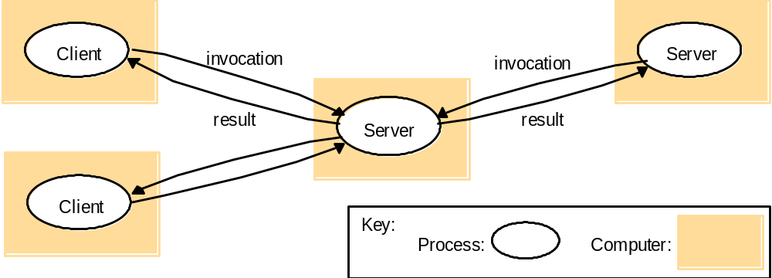
Figure 2.2
Clients invoke individual servers

Slide 20
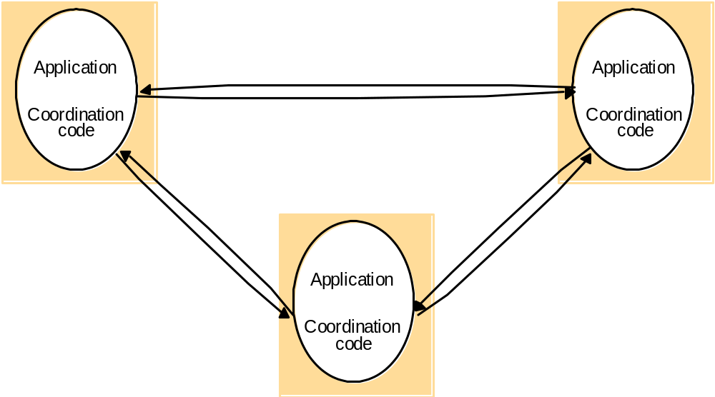
Peer to Peer
In this architecture all of the processes involved in a task or activity play similar roles, interacting cooperatively as peers without any distinction between client and server processes or the computers that they run on.
Figure 2.5
A distributed application based on peer processes

Slide 21
Variations on the client-server model
Services provided by multiple servers
Proxy servers and caches
Mobile Code
Mobile Agents

Slide 22
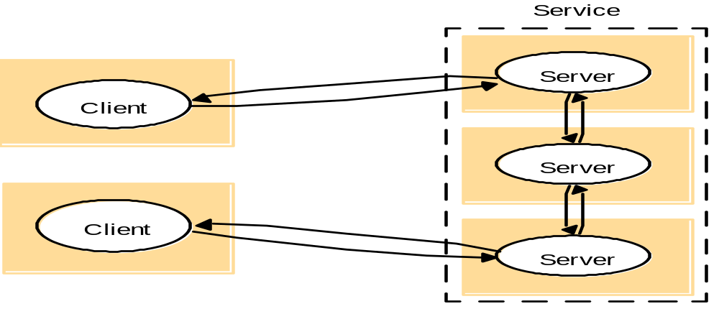
Figure 2.3
A service provided by multiple servers
Services may be implemented as several server processes in separate host computers to provide a service to client processes. The web provides a common example of partitioned data in which each web server manages its own set of resources. A user can employ a browser to access a resource at any one of the servers.

Slide 23
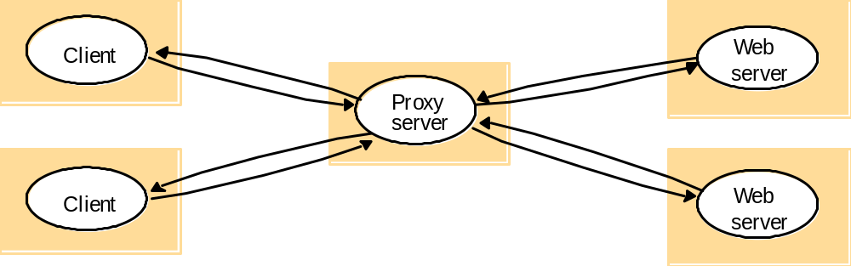
Figure 2.4
Web proxy server
A cache is a store of recently used data objects. Web proxy servers provide a shared cache of web resources for the client machines at a site or across several sites. The purpose of proxy servers is to increase availability and performance of the service by reducing the load on the wide-area network and web servers.

Slide 24
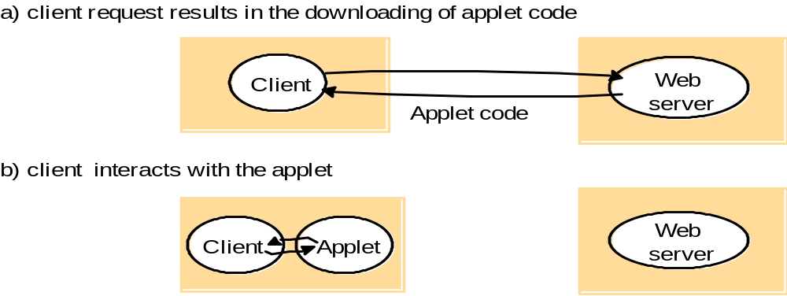
Figure 2.6
Web applets
Applets are example of mobile code – the user running a browser selects a link to an applet whose code is stored on a web server; the code is downloaded to the browser and runs there.
Advantage : good interactive response since it does not suffer from the delays or variability of network bandwidth.

Slide 25
Mobile agents
  A mobile agent is a running program (including both code and data) that travels from one computer to another in a network carrying out a task on someone’s behalf, such as collecting information, and eventually returning with the results.
  A mobile agent may make many invocations to local resources at each site it visits

Slide 26
Figure 2.7
Thin clients and compute servers
Compute server
Network computer or PC
Thin
network
Application
Client
Process
Network Computers – when applns run on a desktop computer local to the user, network computer downloads its OS and any appln software needed by the user from a remote file server. Applications are run locally but the files are managed by a remote file server.
Thin clients – refers to a software layer that supports a window-based user interface on a computer that is local to the user while executing application programs on a remote computer. Instead of downloading the code of applications into the user’s computer, it runs them on a compute server – a powerful computer that has the capacity to run large numbers of applns simultaneously.

Slide 27
Architectural models (cont.)
Software layers
System architectures
Variations on the client-server model
Interfaces and objects
Design requirements for distributed architectures

Slide 28
Software layers
Applications, services
Middleware
Operating system
Computer and network hardware

Slide 29
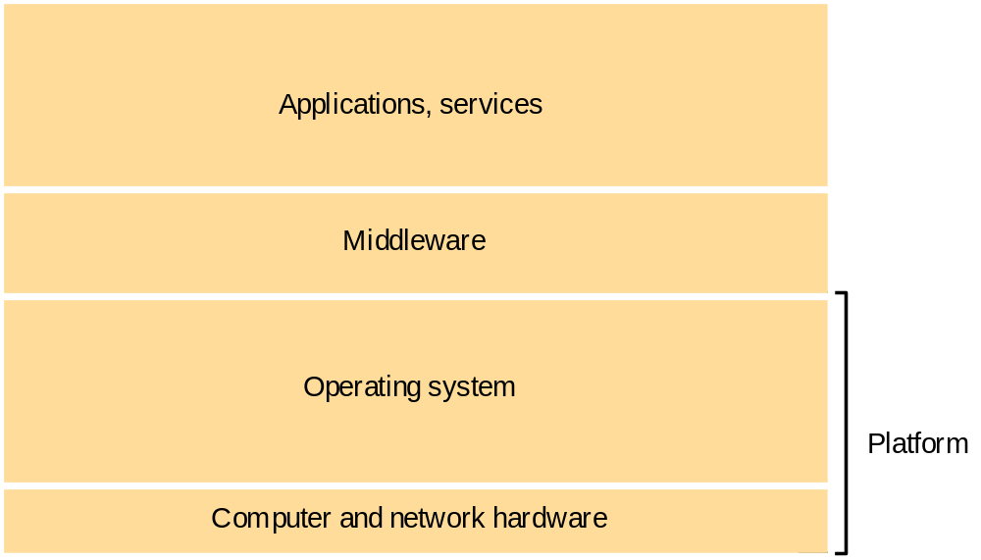
Figure 2.1
Software and hardware service layers in distributed systems

Slide 30
Software Layers
Platform - The lowest level hardware and software layers are often referred to as a platform for distributed systems and applications. These low-level layers provide services to the layers above them.
Middleware – defined as a layer of software whose purpose is to mask heterogeneity and to provide a convenient programming model to application programmers. Examples of object oriented middleware products are CORBA, Java RMI, web services. Limitations of middleware : Many distributed applications rely entirely on the services provided by the available middleware to support their needs for communication and data sharing.

Slide 31
Fundamental Models
Interaction model
Failure model
Security model

Slide 32
Interaction model
Performance of communication channels
Computer clocks and timing events
Two variants of the interaction model

Slide 33
Performance of communication channels
Communication over a computer network has the following performance characteristics relating to latency, bandwith and jitter.
The delay between the sending of a message by one process and its receipt by another is referred to as latency.
Bandwidth of a computer network is the total amount of information that can be transmitted over it in a given time.
Jitter is the variation in the time taken to deliver a series of messages.

Slide 34
Computer clock and timing event
Each computer in a distributed system has its own internal clock, which can be used by local processes to obtain the value of the current time.
Therefore two processes running on different computers can associate timestamps with their events. However, even if two processes read their clocks at the same time, their local clocks may supply different time values.
The term clock drift rate refers to the relative amount that a computer clock differs from a perfect reference clock.

Slide 35
There are several approaches to correcting the times on computer clocks. For example, computers may use radio receivers to get time readings from the Global Positioning System with an accuracy of about 1 microsecond.
But this cannot be used inside the building.
On the other hand, a computer that has an accurate time source can send timing messages to other computers in its network.
The resulting agreement between the times on the local clocks can be affected by variable message delays

Slide 36
Two variants of the interaction model
Synchronous distributed system
  The time to execute each step of a process has known lower and upper bounds.
  Each message transmitted over a channel is received within a known bounded time
  Each process has a local clock whose drift rate from real time has a known bound.
Asynchronous distributed system
  No bound on process executiong speeds
  No bound on message transmisson delays
  No bound on clock drift rates.

Slide 37
Event ordering
we are interested in knowing whether an event
at one process occurred before, after or concurrently with another event at another process.
For example, consider the following set of exchanges between a group of email users, X, Y, Z and A, on a mailing list:
1. User X sends a message with the subject Meeting.
2. Users Y and Z reply by sending a message with the subject Re: Meeting.

Slide 38
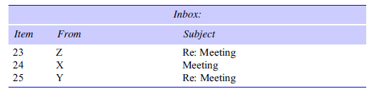
In real time, X’s message is sent first, and Y reads it and replies;
Z then reads both X’s message and Y’s reply and sends another reply, which references both X’s and Y’s messages.
But due to the independent delays in message delivery, the messages may be delivered as shown

Slide 39
The clocks of all three need to be synchronized perfectly to avoid this inconsistency.
But in DS, clocks cannot be synchronized perfectly, So Lampert proposed “logical Clock”.

Slide 40
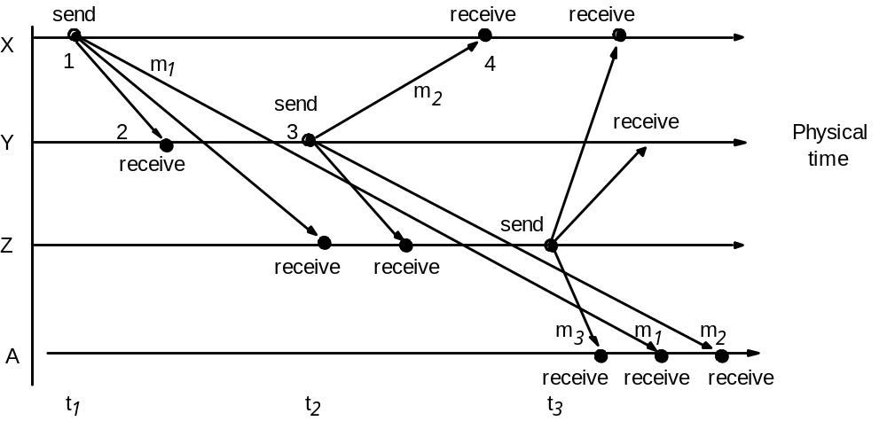
Figure 2.9
Real-time ordering of events
Consider the following set of exchanges between a group of email users X,Y,Z and A on a mailing list:
A might see 1. Re: Meeting from Z
2. Meeting from X
3.Re: Meeting from Y
If the clocks on X’s, Y’s and Z’s computers are synchronized, then each message could carry the time on the local computer’s clock when it was sent. For ex, messages m1, m2 and m3 would carry times t1, t2 and t3 where t1<t2<t3.

Slide 41
Failure Model
The failure model defines the ways in which failure may occur in order to provide an understanding of the effects of failures.
1.

Slide 42
Omission failures :When a process or communication channel fails to perform actions that it is supposed to do.
  Process omission failure
  omission failure of a process is to crash. Meaning is that the process has halted and will not execute any further steps of its program ever.
  A process crash is called fail-stop if other processes can detect certainly that the process has crashed.
  Fail-stop behaviour can be produced in a synchronous system if the processes use timeouts to detect when other processes fail to respond and messages are guaranteed to be delivered.

Slide 43
Communication Omission Failure
The communication channel produces an omission failure if it does not transport a message from one outgoing message buffer to other process incoming message buffer.
This is known as ‘dropping messages’ and is generally caused by lack of buffer space at the receiver or at an intervening gateway, or by a network transmission error.
.

Slide 44
Loss of messages between the sending process and the outgoing message buffer refers, ”send omission failures”.
Loss of messages between the incoming message buffer and the receiving process is “receive-omission failures”.
Loss of messages in between is called “channel omission failures”.

Slide 45
Failure model
Arbitrary failures – Byzantine failure is used to describe the worst possible failure semantics, in which any type of error may occur. Ex: a process may set wrong values in its data items, or it may return a wrong value in response to an invocation.
Timing failures – are applicable in synchronous distributed systems where time limits are set on process execution time, message delivery time and clock drift rate.
Masking failures – Each component in a distributed system is generally constructed from a collection of other components. It is possible to construct reliable services from components that exhibit failures. For example, multiple servers that hold replicas of data can continue to provide a service when one of them crashes.

Slide 46
Reliability of one-to-one communication - validity and integrity
Validity: Any message in the outgoing message buffer is eventually delivered to the incoming message buffer.
Integrity: The message received is identical to one sent, and no messages are delivered twice.

Slide 47
Figure 2.11
Omission and arbitrary failures
Class of failure
Affects
Description
Fail-stop
Process
Process halts and remains halted. Other processes may
detect this state.
Crash
Process
Process halts and remains halted. Other processes may
not be able to detect this state.
Omission
Channel
A message inserted in an outgoing message buffer never
arrives at the other end’s incoming message buffer.
Send-omission
Process
A process completes a
s end,
but the message is not put
in its outgoing message buffer.
Receive-omission
Process
A message is put in a process’s incoming message
buffer, but that process does not receive it.
Arbitrary
Process or
Process/channel exhibits arbitrary behaviour: it may
(Byzantine)
channel
send/transmit arbitrary messages at arbitrary times,
commit omissions; a process may stop or take an
incorrect step.

Slide 48
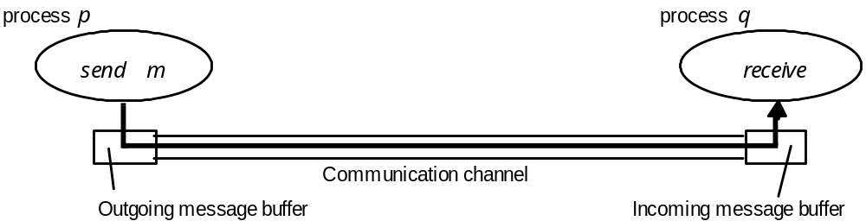
Figure 2.10
Processes and channels

Slide 49
Figure 2.12
Timing failures
Class of Failure
Affects
Description
Clock
Process
Process’s local clock exceeds the bounds on its
rate of drift from real time.
Performance
Process
Process exceeds the bounds on the interval
between two steps.
Performance
Channel
A message’s transmission takes longer than the
stated bound.

Slide 50
Security model
Protecting objects
Securing processes and their interactions
The enemy
Defeating security threats
Other possible threats from the enemy – DoS, Mobile code.
The uses of security models – Encryption and Access control

Slide 51
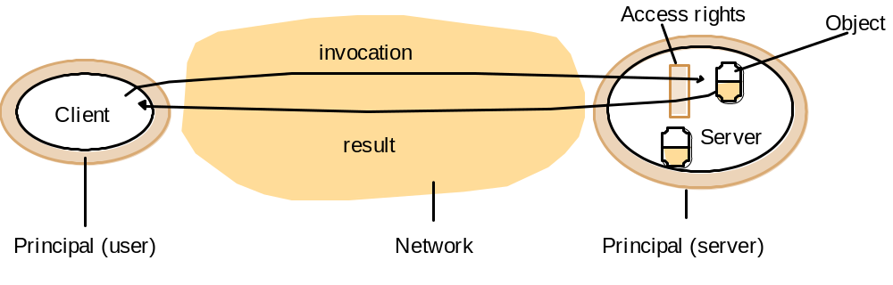
Protecting Objects
The diagram shows a server that manages a collection of objects on behalf of some users. The users can run client programs that send invocations to the server to perform operations on the objects. The server carries out the operation specified in each invocation and sends the result to the client.
Some objects may hold a user’s private data, such as their mailbox, and other objects may hold shared data such as webpages.

Slide 52
Securing processes and their interactions
Processes interact by sending messages. The messages are exposed to attack
because the network and the communication service that they use is open, to enable
any pair of processes to interact.
Servers and peer processes expose their interfaces, enabling invocations to be sent
to them by any other process.

Slide 53
Figure 2.14
The enemy
Copy of m
The enemy
m’
Process
p
m
Process
q
Communication channel
Threats to processes: A Process that is designed to handle incoming requests may receive a message
from any process in the distributed system, and it cannot necessarily determine the identity of the
Sender.
Threats to Servers: Since a server can receive invocations from many different clients, it cannot
necessarily determine the identity of the principal behind any particular invocation. Even if a server
requires the inclusion of the principal’s identity in each invocation, an enemy might generate an invocation
With a false identity.
Threats to clients: When a client receives the result of an invocation from a server, it cannot necessarily
tell whether the source of the result message is from the intended server or from an enemy.
Threats to communication channels: An enemy can copy, alter or inject messages as they travel across
the network and its intervening gateways. Such attacks present a threat to the privacy and integrity of
Information as it travels over the network and to the integrity of the system.

Slide 54
Defeating Security threats
Principal
A
Principal
B
Process
p
Secure channel
Process
q
Cryptography and shared secrets: Suppose that a pair of processes (client and server) share
a secret; that is they both know the secret but no other process in the distributed system
knows its.
Authentication: The use of shared secrets and encryption provides the basis for the
Authentication of messages – proving the identities supplied by their senders. The basic
authentication technique is to include in a message an encrypted portion that contains
enough of the contents of the message to guarantee its authenticity.
The authentication portion of a request to a file server to read part of a file, for ex, might
include a representation of the requesting principal’s identity, the identity of the file and
the date and time of the request, all encrypted with a secret key shared between the file server
and the requesting process.
Secure Channels: VPNs, SSL

